Slide 1
Priority Queue
Israt Jahan Rinky
Lecturer
Dept. of CSE, Varendra University.

Slide 2
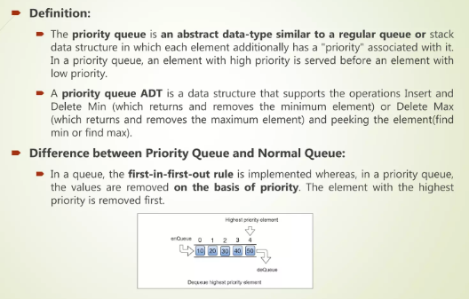
Priority Queue

Slide 3
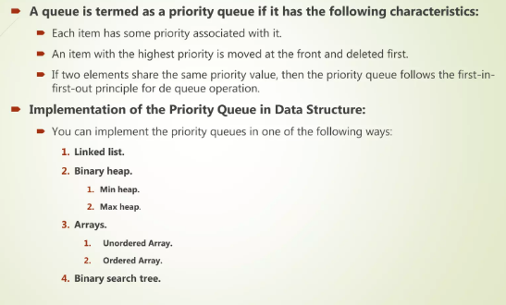
Characteristics of Priority Queue

Slide 4
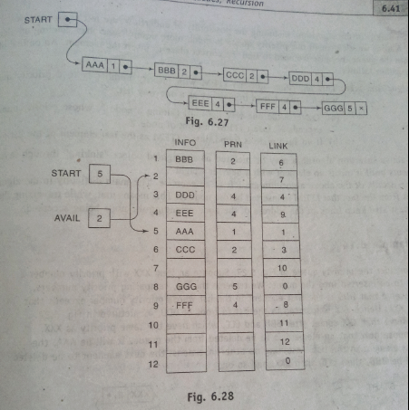

Slide 5
